Slide 1
Other Income
Pub 17 Chapter 12
Pub 4012 Tab D
(Federal 1040-Line 21)
(NJ 1040 –Lines 23 & 25)
Notes:
1

Slide 2
NJ Gambling Income
Losses are deducted from winnings before reporting the net on NJ 1040 Line 23
NJ Lottery winnings of $10,000 or less per occurrence are not taxable in NJ; anything above $10,000, total amount is taxable
Lottery winnings from other states are fully taxable
Winnings/losses will not automatically flow through from Federal to NJ return
Capture gambling information in NJ Checklist Income Subject to Tax section for later entry in the TaxSlayer State section

Slide 3
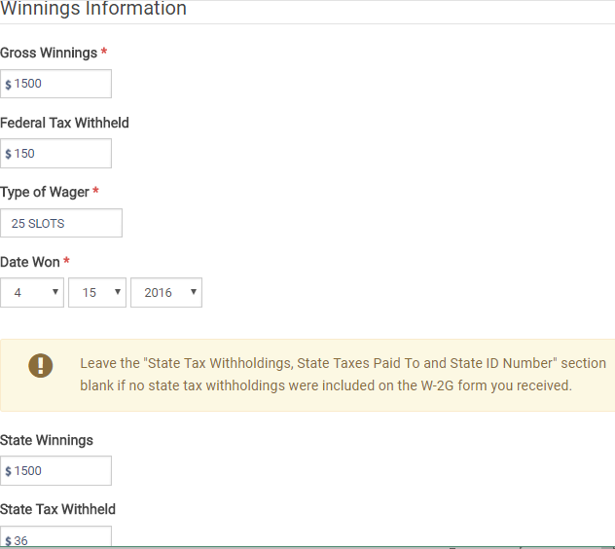
TS - Federal Gambling Winnings – W-2G Federal section \ Income \ Enter Myself \ Other Income \ Gambling Winnings (W2-G)
Gross winnings
Leave state section blank unless
NJ taxes were withheld
Notes:
3

Slide 4
Recoveries
Pub 17 Chapter 12
Recoveries of amounts deducted in prior years may have to be reported as Other Income in current year. May include:
Property tax rebates (e.g. - PTR & Homestead Benefit) – covered in more detail in later module
Reimbursements for medical expenses claimed in prior years
Other refunds of Schedule A deductions
Use State Refund Worksheet in TaxSlayer to determine how much of recovery is taxable (if prior year info is available)
NJ property tax recoveries are not taxable in NJ. Since 1040 Line 21 Other Income totals flow through to NJ 1040 Line 25, have to adjust NJ 1040 Line 25 Other Income. Capture property tax recovery info in NJ Checklist Income Subject to Tax section for later entry in the Taxslayer State section
Notes:
Handling of property tax recoveries will be handled in a separate module later in training
4

Slide 5
Cancellation of Credit Card Debt
Cancellation of credit card debt is in scope for all counselors as part of Advanced certification
Reported on 1099-C
1099-C income taxable on Federal return
Exception: taxpayer in bankruptcy or insolvent (liabilities exceeded assets) immediately before debt was cancelled
If bankrupt or insolvent, Out of Scope
Notes:
5

Slide 6
Cancellation of Credit Card Debt
(cont’d)
Enter in Federal section \ Income \ Enter Myself \ Other Income Cancellation of Debt (1099-C, Form 982) \ Cancellation of Debt (Form 1099-C)
1099-C income is not taxable in NJ
TaxSlayer automatically excludes cancellation of debt income from NJ 1040 Lines 25 Other Income
See Pub 4012 page D-63 and specific instructions in Special Topics document on TaxPrep4Free.org Preparer page
Notes:
6

Slide 7
Foreclosures/Abandonments and Cancellation of Debt on Mortgage
Foreclosure/Abandonments and Cancellation of Debt on a home mortgage loan has been declared Out of Scope for NJ preparers due to its complexity
Note: As of 2017, this exclusion from income has expired
Notes:
7

